Slide 1
TASK 03

Slide 2
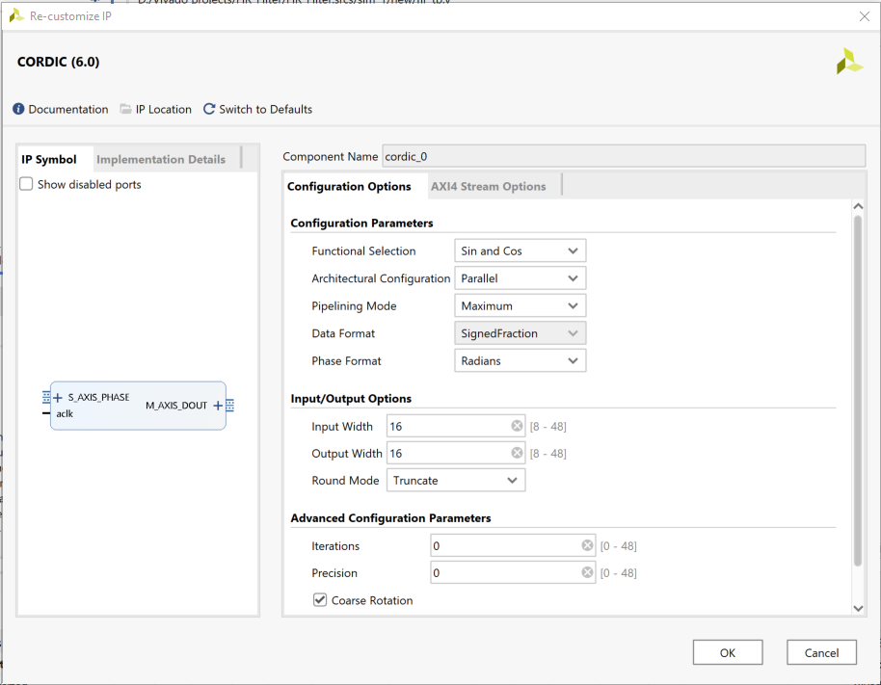
Properties of IP CORDIC to generate the cosine and sine waveform
Here it is using the Signed Fraction.

Slide 3
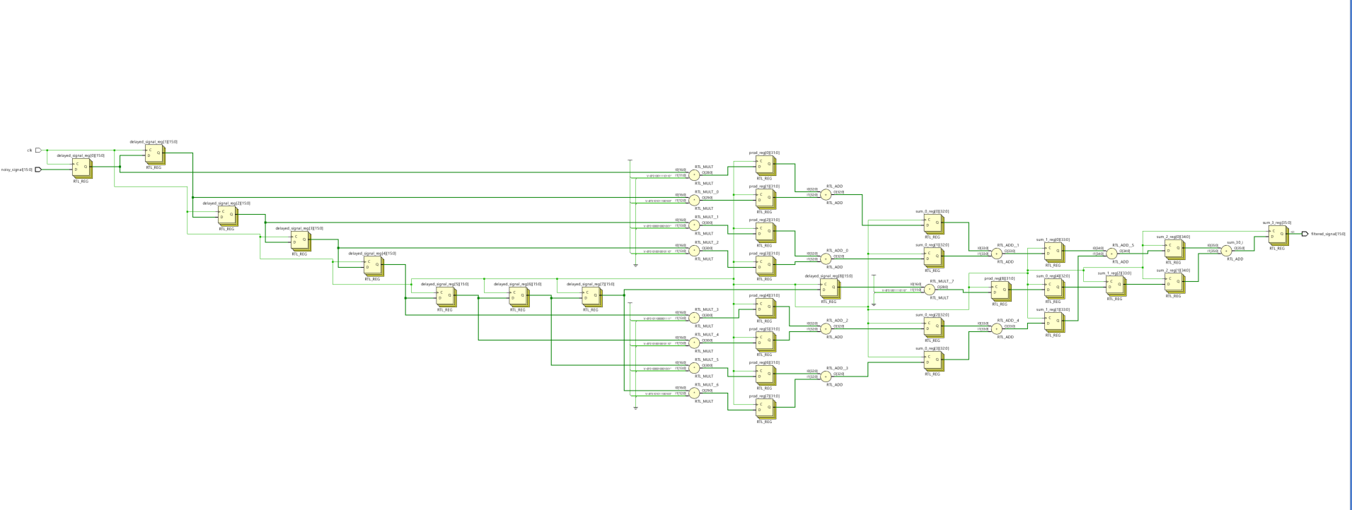
FIR FILTER HARDWARE DIAGRAM

Slide 4
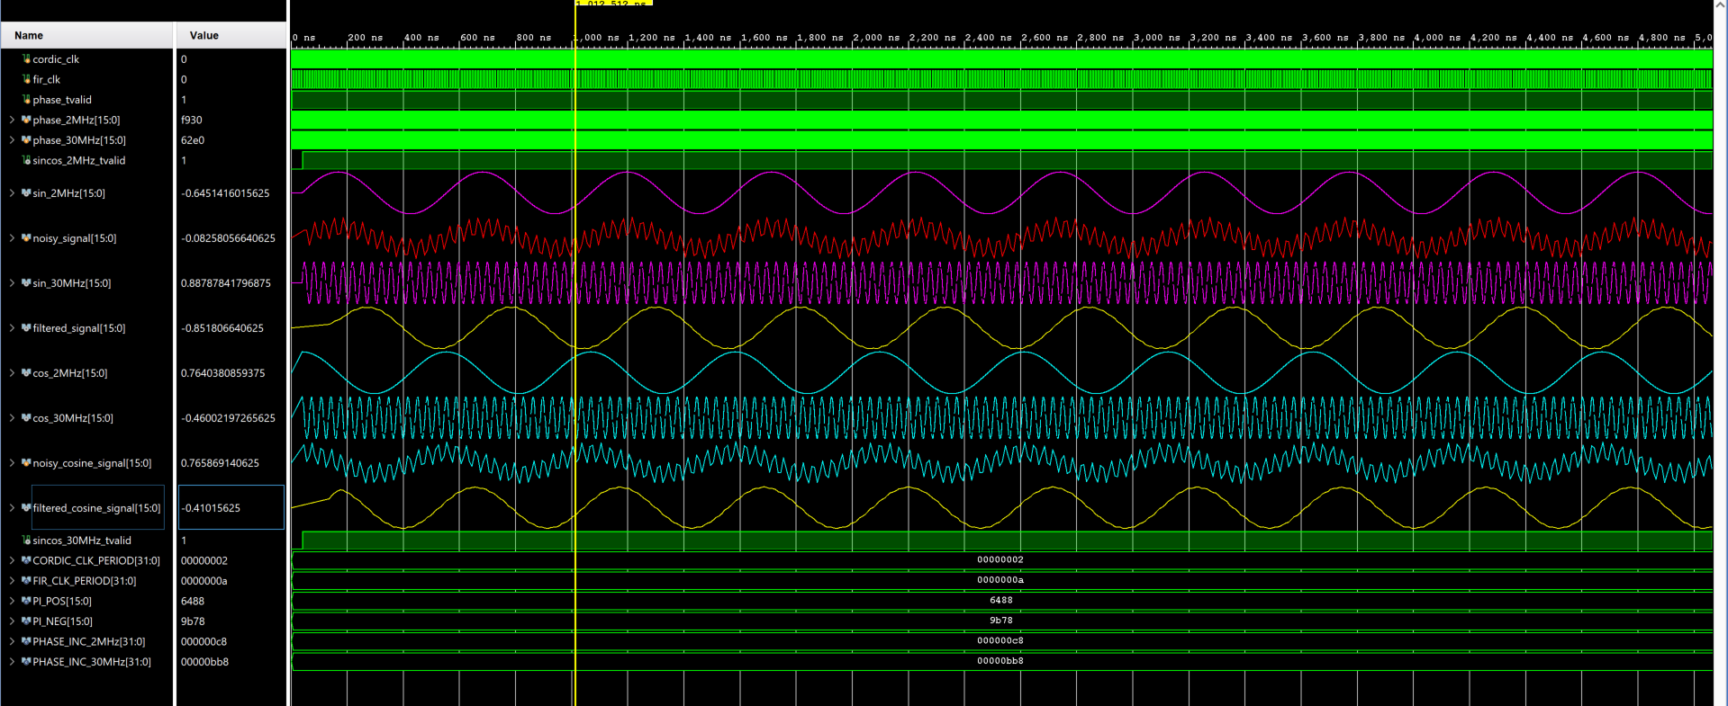
FIR Filter Waveform (COSINE AND SINE)
Cosine waveform
Sine waveform

Slide 5
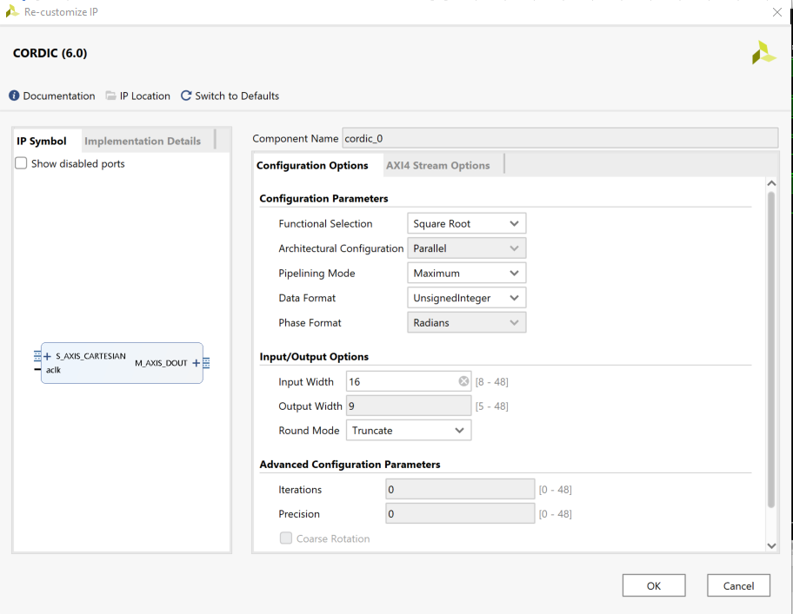
Properties of IP CORDIC to use Square Root Function
Here it is using the Unsigned Integer.

Slide 6
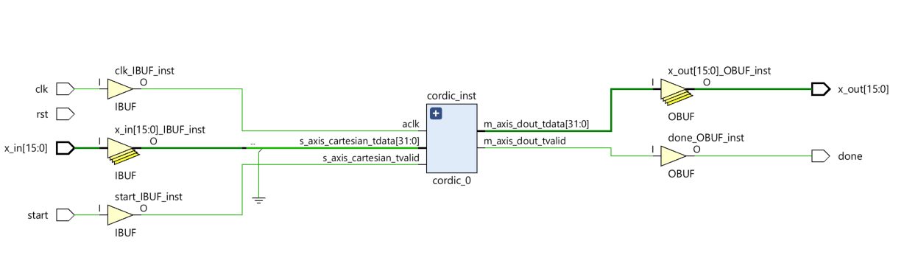
Square Root using CORDIC IP HARDWARE DIAGRAM

Slide 7
//TEST BENCH
module tb_sqrt;
// Inputs
reg clk;reg rst; reg start; reg [15:0] x_in;
// Outputs
wire [15:0] x_out;wire done;
// Instantiate the DUT (Device Under Test)
sqrt uut (
.clk(clk), .rst(rst),.start(start),.x_in(x_in),.x_out(x_out),.done(done)
);
// Clock generation (10ns period)
always #5 clk = ~clk;
initial begin
// Initial values
clk = 0; rst = 1; start = 0; x_in = 0;
// Reset pulse
#20;
rst = 0;
// Test Case 1: sqrt(25) = 5
@(posedge clk);
x_in = 16'd25; start = 1;
@(posedge clk);
start = 0;
wait (done); $display("Input: %d, Output (sqrt): %d", x_in, x_out);
// Test Case 2: sqrt(100) = 10
@(posedge clk); x_in = 16'd100;
start = 1;
@(posedge clk); start = 0;
wait (done);
$display("Input: %d, Output (sqrt): %d", x_in, x_out);
// Test Case 3: sqrt(2) ≈ 1.41 (expect integer truncation)
@(posedge clk);x_in = 16'd64;
start = 1; @(posedge clk);
start = 0;
wait (done);
$display("Input: %d, Output (sqrt): %d", x_in, x_out);
#50;
$finish;
end
endmodule
//MODULE
module sqrt(
input wire [15:0] x_in,
input wire clk,
input wire rst,
input wire start,
output wire [15:0] x_out,
output wire done
);
wire ready, valid;
assign ready = 1'b1; // Always ready to accept data
assign done = valid; // Output becomes valid when core signals done
cordic_0 cordic_inst (
.aclk(clk),
.s_axis_cartesian_tvalid(start),
.s_axis_cartesian_tdata(x_in), // Must be 32 bits (X, Y); Y=0
//.s_axis_cartesian_tready(), // Can be left unconnected
.m_axis_dout_tvalid(valid),
.m_axis_dout_tdata(x_out)
);
endmodule

Slide 8
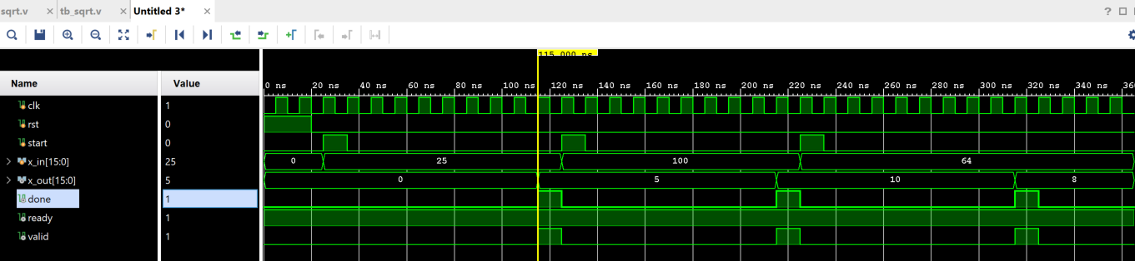




Square Root using CORDIC IP Waveform

Slide 9
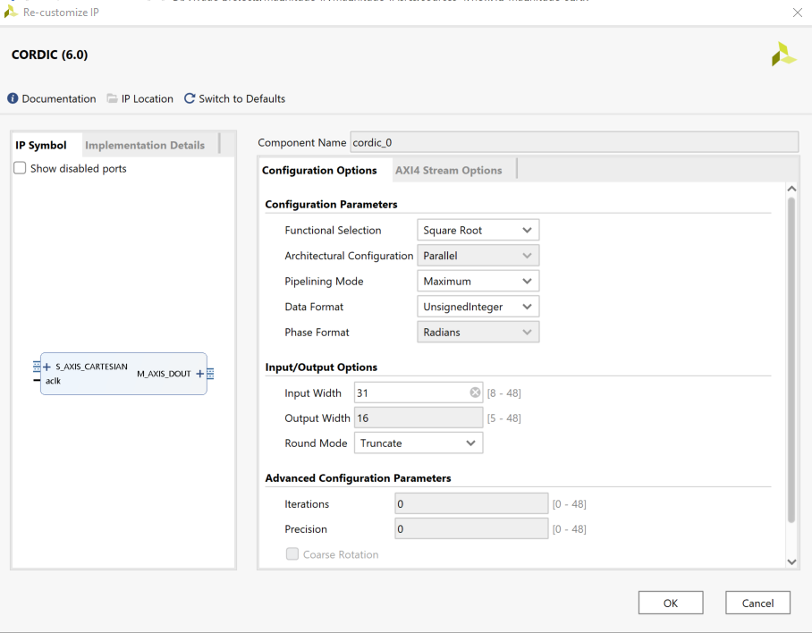
Properties of IP CORDIC to use Square Root Function for the calculation of magnitude
Here it is using the Unsigned Integer.

Slide 10
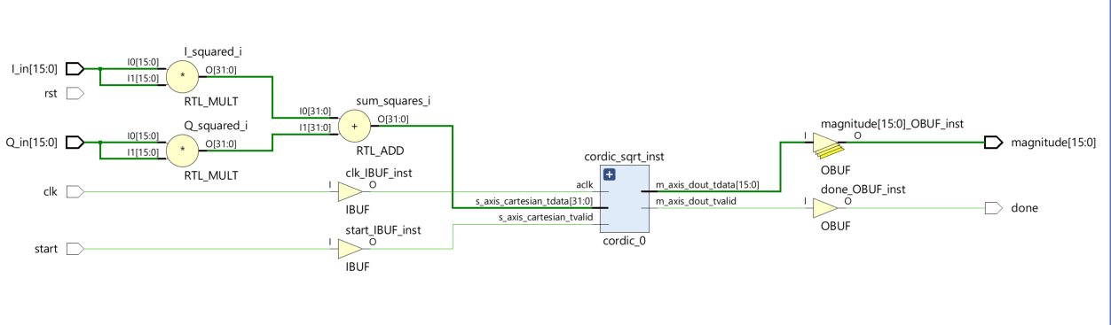
Hardware diagram of magnitude calculator ip

Slide 11
//FOR UNSIGNED INTEGERS
//MODULE
module iq_magnitude_sqrt (
input wire clk,
input wire rst,
input wire start, // Start signal
input wire [15:0] I_in, // In-phase component (unsigned)
input wire [15:0] Q_in, // Quadrature component (unsigned)
output wire [15:0] magnitude, // Magnitude (result of sqrt(I^2 + Q^2))
output wire done // Done signal
);
// Step 1: Squaring I and Q
wire [31:0] I_squared = I_in * I_in;
wire [31:0] Q_squared = Q_in * Q_in;
// Step 2: Add them to get sum of squares
wire [31:0] sum_squares = I_squared + Q_squared;
// Step 3: CORDIC square root
wire [15:0] sqrt_out;
wire sqrt_valid;
cordic_0 cordic_sqrt_inst (
.aclk(clk),
.s_axis_cartesian_tvalid(start),
.s_axis_cartesian_tdata(sum_squares),
.m_axis_dout_tvalid(sqrt_valid),
.m_axis_dout_tdata(sqrt_out)
);
// Output assignments
assign magnitude = sqrt_out; // 16-bit magnitude from sqrt
assign done = sqrt_valid;
endmodule
//TEST BENCH
module tb_iq_magnitude_sqrt;
// Inputs
reg clk; reg rst; reg start; reg [15:0] I_in; reg [15:0] Q_in;
// Outputs
wire [15:0] magnitude; wire done;
// Instantiate the DUT (Design Under Test)
iq_magnitude_sqrt uut (
.clk(clk),.rst(rst),.start(start),.I_in(I_in),.Q_in(Q_in), .magnitude(magnitude),.done(done)
);
// Clock generation
always #5 clk = ~clk; // 100 MHz clock (period = 10 ns)
initial begin
// Initialize inputs
clk = 0; rst = 1; start = 0; I_in = 0; Q_in = 0; // Reset pulse
#20;
rst = 0;
// --- Test Case 1: I = 3, Q = 4 (Expect magnitude = 5) ---
I_in = 3; Q_in = 4;
#10 start = 1;
#10 start = 0;
// Wait for done
wait (done == 1);
$display("Test 1: I=3, Q=4 => magnitude=%d (Expected: 5)", magnitude);
// --- Test Case 2: I = 6, Q = 8 (Expect magnitude = 10) ---
#20;
I_in = 6; Q_in = 8;
#10 start = 1;
#10 start = 0;
wait (done == 1);
$display("Test 2: I=6, Q=8 => magnitude=%d (Expected: 10)", magnitude);
// --- Test Case 2: I = 6, Q = 8 (Expect magnitude = 10) ---
#20;
I_in = 123; Q_in = 456;
#10 start = 1;
#10 start = 0;
wait (done == 1);
$display("Test 2: I=123, Q=456 => magnitude=%d (Expected: 472.29)", magnitude);
// --- Done ---
#50;
$finish;
end
endmodule

Slide 12
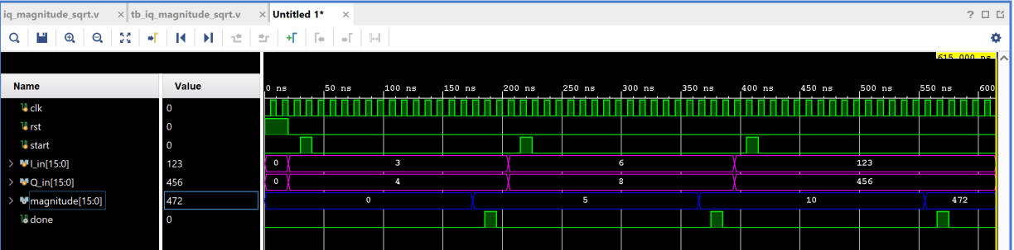






MAGNITUDE CALCULATION USING Square Root CORDIC IP Waveform

Slide 13
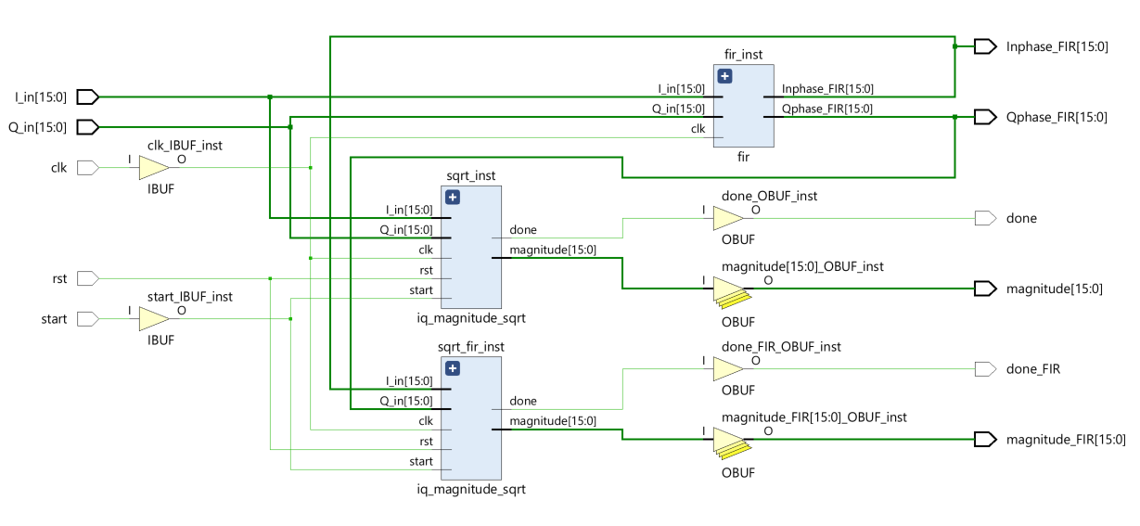
High LEVEL Block Diagram of Task03 (pipelined FIR)

Slide 14
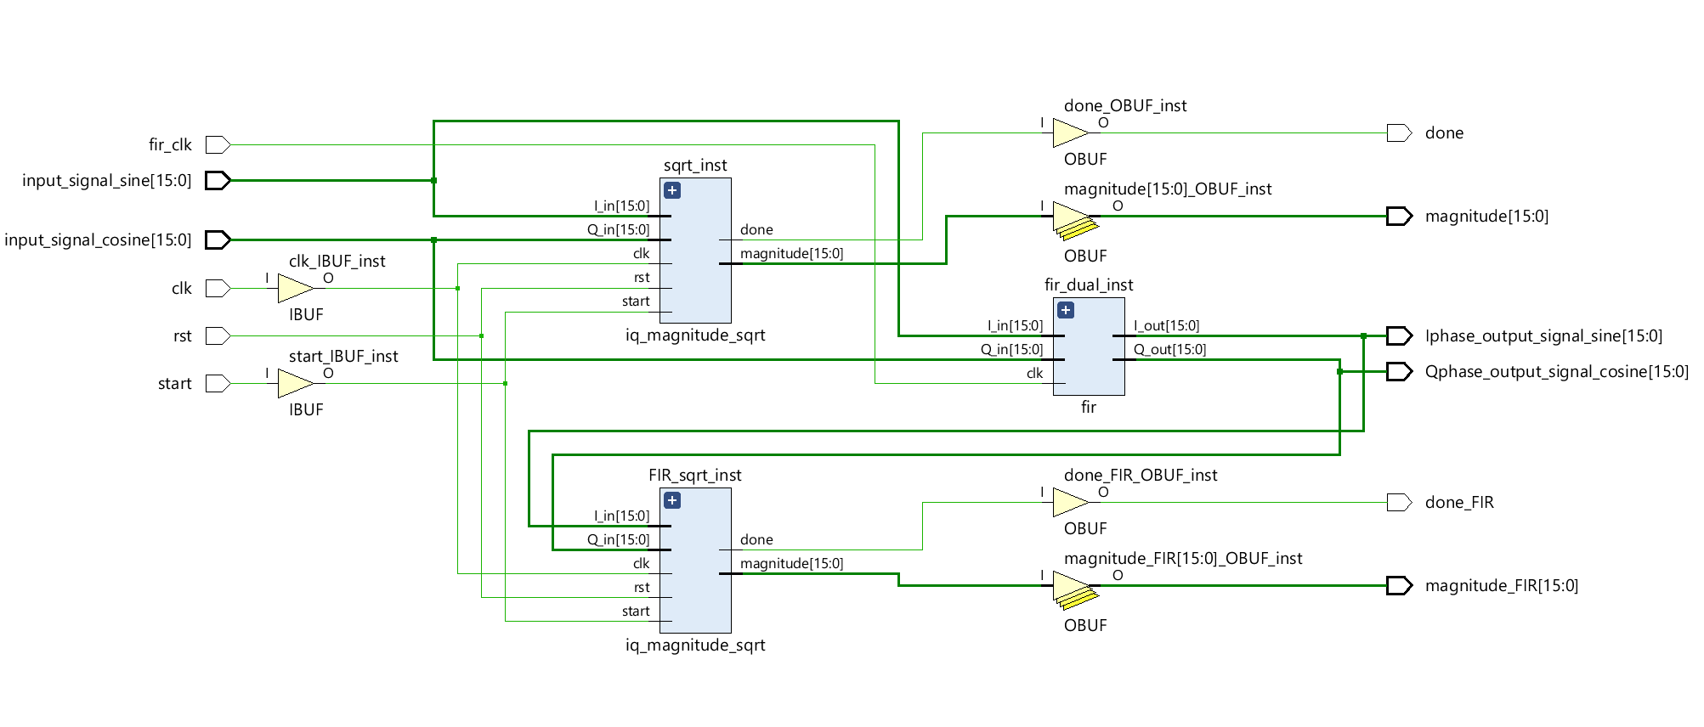
High LEVEL Block Diagram of Task03 (NON-pipelined FIR)

